Slide 1



WIRELESS SERVO MOTOR CONTROL WITH ARDUINO
guided by:
G . Gnana Priya
ap senior grade(ece)
A NANTHA KUMAR(953621106006)
HARRIS BABU P(953621106028)
ANBARASAN A(953621106007)

Slide 2
ABSTRACT:
The "Wireless Servo Motor Control with Arduino" project for remotely controlling servo motors using Arduino wireless communication technology.
Servo motors are widely used in robotics, automation, and various other applications that require precise control over angular motion. This project offers a wireless solution to control servo motors, eliminating the need for physical connections and enabling remote operation.
This project presents a wireless servo motor control system implemented with Arduino and the NRF24L01 wireless communication module.
The NRF24L01 module is RF module.

Slide 3
PROPOSED METHOD :
Hardware Setup:
Assemble the hardware components, which include two Arduino boards (one for the sender and one for the receiver), NRF24L01 wireless communication modules, servo motors, and a power source (usually a battery or a power supply).
Wiring Connections:
Connect the NRF24L01 modules to each Arduino.
Connect the servo motor to the receiver Arduino for servo control.
Arduino Programming:
Write code for both the sender and receiver Arduinos.
In the sender Arduino code, include logic to read input from a user interface potentiometers this input to servo control commands.
Use the NRF24L01 library to set up wireless communication and transmit the control commands to the receiver

Slide 4
Receiver Code:
In the receiver Arduino code, configure the NRF24L01 module to receive data packets from the sender and use them to control the servo motor.
Servo Motor Control:
Ensure that the servo motor movement is smooth and accurate.
By following this we can create a wireless servo motor control system using Arduino and NRF24L01, making it suitable for various applications where remote and precise control of servo motors is required.
ARUDINO

Slide 5
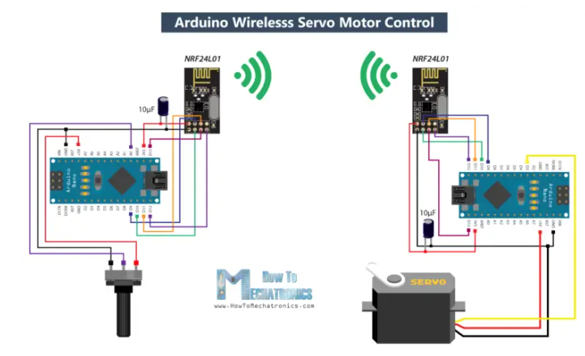
Block diagram with parameters
ARUDINO Nano
ARUDINO
Nano
Servo motor
Potentiometer
(10K OHM)

Slide 6
HARDWARE:
SOFTWARE:
NRF24L01 Module
Potentiometer
Arudino nano
Servo motor
Breadboard
Jumper wire
Arduino Software (IDE)

Slide 7
RESULT:

Slide 8
reference
https://howtomechatronics.com/tutorials/arduino/how-to-build-an-arduino-wireless-network-with-multiple-nrf24l01-modules/
https://youtu.be/xb7psLhKTMA?feature=shared

Slide 9
Thank you

